Slide 1



Idiomatic Programmer Learning Keras
Computer Vision Workshop Version: July 2019

Slide 2
Idiomatic Programmer Learning Keras
Repo: github.com/GoogleCloudPlatform/keras-idiomatic-programmer
Workshops, Handbooks, and Model Zoo

Slide 3
Computer Vision - Models
Part 1 : Covered in Neural_Network Study Pack
Part 2 : Covered in Convolutional_Neural Network Study Pack
Part 3 : Covered in Wide_Convolutional_Neural_Networks
Part 4: Covered in Advanced_Convolutional_Neural_Networks
Part 5: Covered in Mobile_Networks

Slide 4
MobileNet
Mobile Neural Networks
MobileNet is an architecture introduced by Google in 2017 for producing smaller networks which can fit on mobile and embedded devices, while maintaining accuracy close to their larger network counterparts. The MobileNet architecture replaces normal convolutions with depthwise separable convolutions to further reduce computational complexity.
Two additional hyperparameters were introduced for thinning the size of the network: width multiplier and resolution multiplier.

Slide 5
MobileNet
Width Multiplier
The first hyperparameter introduced was the width multiplier α (alpha), which thins a network uniformly at each layer.
The value of α (alpha) is between 0 and 1, and will reduce the computational complexity of a mobile net by α (alpha)**2. Typically values are 0.25 (6%), 0.50 (25%), and 0.75 (56%).
In tests results reported in the paper, a non-thinned mobilenet-224 had a 70.6% accuracy on ImageNet with 4.2 million parameters and 569 million matrix multi-add operations, while a 0.25 (width multiplier) mobilenet-224 had 50.6% accuracy with 0.5 million parameters and 41 million matrix multi-add operations.

Slide 6
MobileNet
Resolution Multiplier
The second hyperparameter introduced was the resolution multiplier ρ (rho), which thins the input shape and consequently the feature map sizes at each layer.
The value of ρ (rho) is between 0 and 1, and will reduced computational complexity of a mobile net by ρ (rho)**2.
In tests results reported in the paper, a 0.25 (resolution multiplier) mobilenet-224 had 64.4% accuracy with 4.2 million parameters and 186 million matrix multi-add operations.

Slide 7
MobileNet
Example Use of Width Multiplier
def stem(inputs, alpha): """ Create the stem group inputs : input tensor alpha : width multiplier """ # Apply the width filter to the number of feature maps filters = int(32 * alpha) # Normal Convolutional block x = layers.ZeroPadding2D(padding=((0, 1), (0, 1)))(inputs) x = layers.Conv2D(filters, (3, 3), strides=(2, 2), padding='valid')(x) x = layers.BatchNormalization()(x) x = layers.ReLU()(x) # Depthwise Separable Convolution Block x = depthwise_block(x, 64, alpha, (1, 1)) return x
#1 Width multiplier for reducing number of filters
#2 Number of filters for stem convolution is reduced
#3 Pass along the width multiplier to the next convolution group

Slide 8
SqueezeNet
SqueezeNet - New Module and Terminology
SqueezeNet is an architecture proposed by joint research of DeepScale and UC Berkeley and Stanford University in 2015. In the corresponding paper, the authors introduced a new type of module, referred to as the fire module, and introduced terminology for microarchitecture, macroarchitecture and metaparameters.
Microarchitecture is the design of modules, or groups.
Macroarchitecture is how the modules, or groups, are connected.

Slide 9
SqueezeNet - Metaparameters
SqueezeNet - Metaparameters
The use of the term metaparameters aided in better distinguishing what a hyperparameter is.
Model Parameters - the weights and biases that are learned during training are the model parameters.
Hyperparameters - the tunable parameters used to train the model.
Metaparameters - the structure of the model architecture that is configurable.

Slide 10
SqueezeNet - Architecture
SqueezeNet - Architecture Goals
The authors wanted to demonstrate a CNN architecture design that would fit on a mobile device and still retain comparable accuracy of AlexNet on ImageNet 2012 dataset,
The authors reported achieving the same results empirically with a 50X reduction (fewer) parameters.
The authors reported that a small CNN architecture could maintain accuracy when compressed, with the DeepCompression algorithm, which reduced the size of the model from 4.8Mb to 0.47Mb.
The work contributed to an emerging field now referred to as compact models.

Slide 11
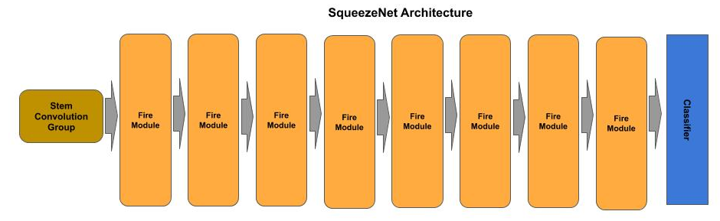
SqueezeNet - Architecture
SqueezeNet - Architecture
The SqueezeNet architecture consists of a stem group, followed by eight fire modules and then a classifier.

Slide 12
SqueezeNet - Architecture
SqueezeNet - Design Principles
The authors describe their design principles to achieve their objectives, which they referred to as strategy 1, 2 and 3:
Strategy 1: Use mostly 1x1 filters instead of the more common convention of 3x3 filters, which give a 9X reduction in the number of parameters. The v1.0 version of SqueezeNet used a 2:1 ratio of 1x1 to 3x3 filters.
Strategy 2: Reduce the number of input filters to the 3x3 layers to further reduce the number of parameters. They refer to this component of the fire module as the squeeze layer.
Strategy 3: Delay downsampling of feature maps to as late as possible in the network, in contrast to the convention of the time to downsample early to preserve accuracy, by using a stride of 1 on the early convolution layers and delay using stride of 2, which are strided convolutions which perform feature map downsampling.

Slide 13
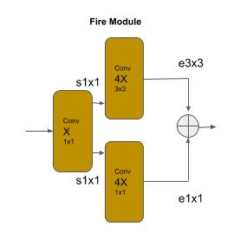
SqueezeNet - Fire Module
SqueezeNet - Fire Module
The fire module consists of two convolutional layers, where the first layer is the squeeze layer and the second layer is the expand layer. The squeeze layer uses a bottleneck convolution to preserve the size of the feature maps (i.e., no downsampling), and reduce the number of filters passed to the expand layer.
The expand layer is a branch of two convolutions, a 1x1 convolution and a 3x3 convolution. The outputs (feature maps) from the convolutions are then concatenated. The expand layer expands the number of feature maps by a factor of 4.

Slide 14
SqueezeNet - Fire Module
SqueezeNet - Fire Module
The code below implements a fire module:
def fire(x, n_filters): ''' Create a fire module ''' # squeeze layer squeeze = Conv2D(n_filters, (1, 1), strides=1, activation='relu', padding='same', kernel_initializer='glorot_uniform')(x) # branch the squeeze layer into a 1x1 and 3x3 convolution and double the number # of filters expand1x1 = Conv2D(n_filters * 4, (1, 1), strides=1, activation='relu', padding='same', kernel_initializer='glorot_uniform')(squeeze) expand3x3 = Conv2D(n_filters * 4, (3, 3), strides=1, activation='relu', padding='same', kernel_initializer='glorot_uniform')(squeeze) # concatenate the feature maps from the 1x1 and 3x3 branches x = Concatenate()([expand1x1, expand3x3]) return x

Slide 15
SqueezeNet - Classifier
SqueezeNet - An Unconventional Classifier
The classifier does not follow the conventional practice of a global averaging pooling layer followed by a dense layer where the number of output nodes equals the number of classes.
Instead, it uses a convolutional layer where the number of filters equals the number of classes, followed by a global averaging pooling layer such that each prior filter (class) is reduced to a single value.
def classifier(x, n_classes): ''' The classifier ''' # set the number of filters equal to number of classes x = Conv2D(n_classes, (1, 1), strides=1, activation='relu', padding='same', kernel_initializer='glorot_uniform')(x) # reduce each filter (class) to a single value x = GlobalAveragePooling2D()(x) x = Activation('softmax')(x) return x

